Slide 1
AMAT 5315 exercises lesson
Xuanzhao Gao

Slide 2
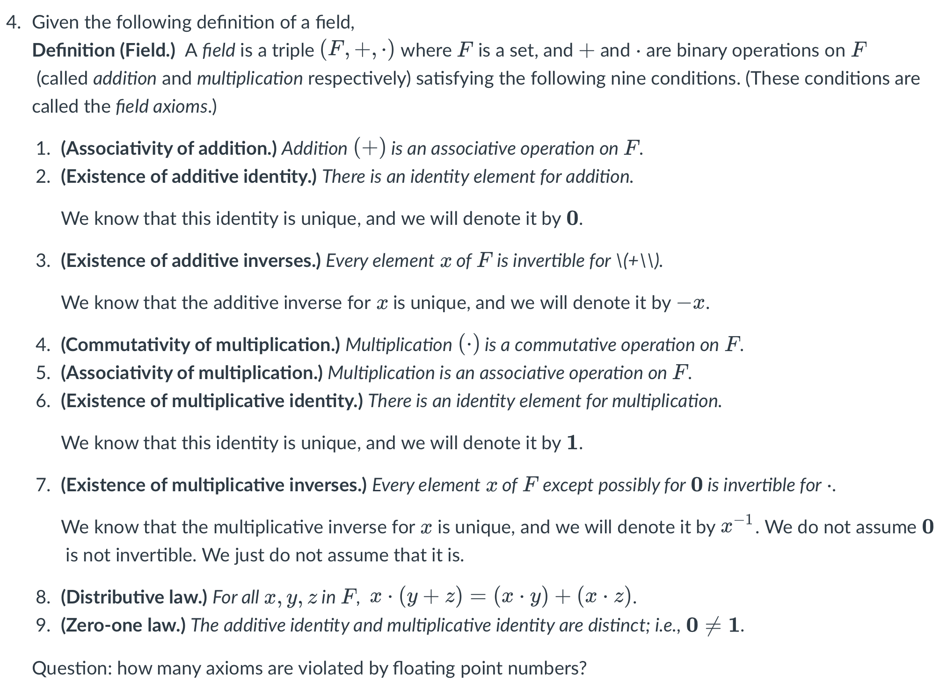
HW1

Slide 3
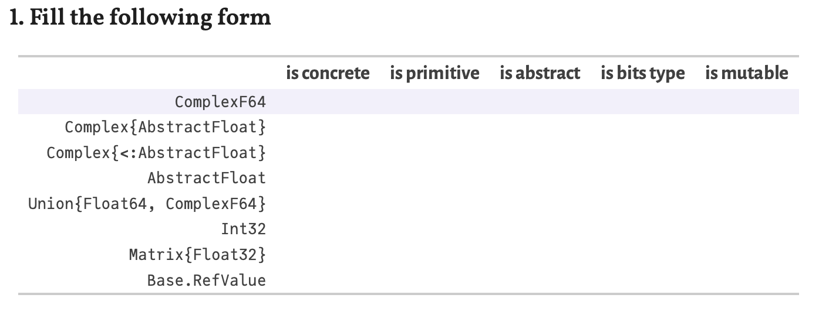
HW2

Slide 4
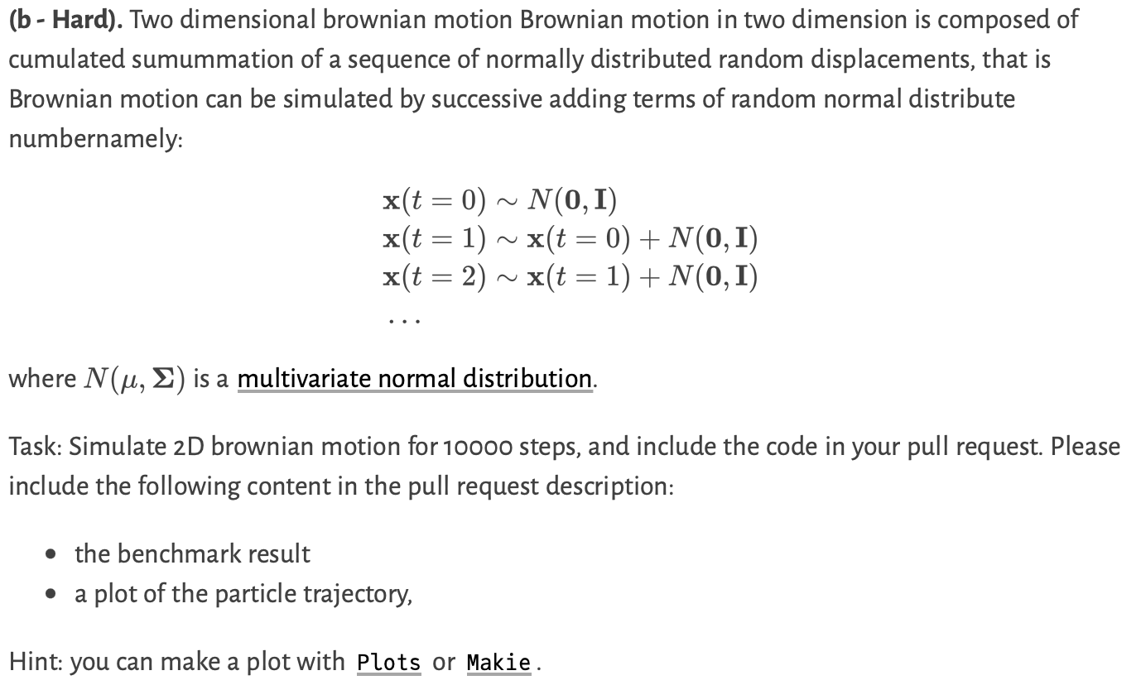
HW2

Slide 5
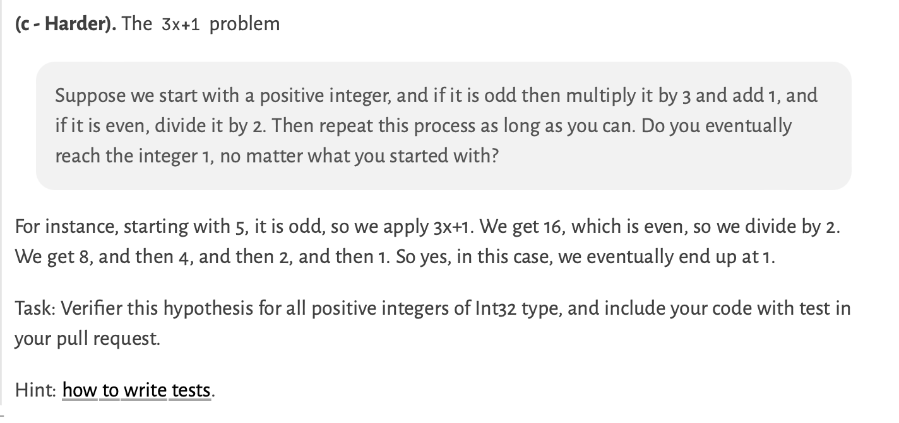

Slide 6
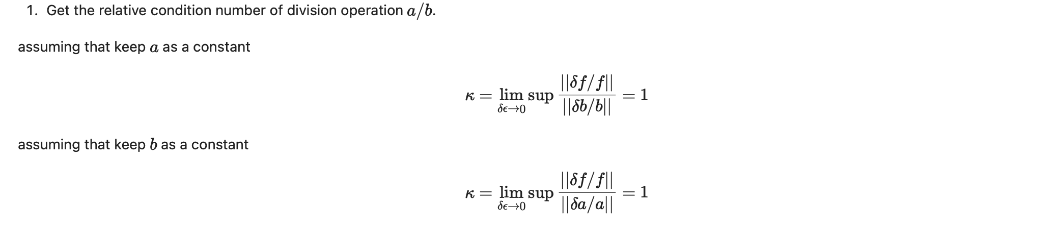
HW3

Slide 7
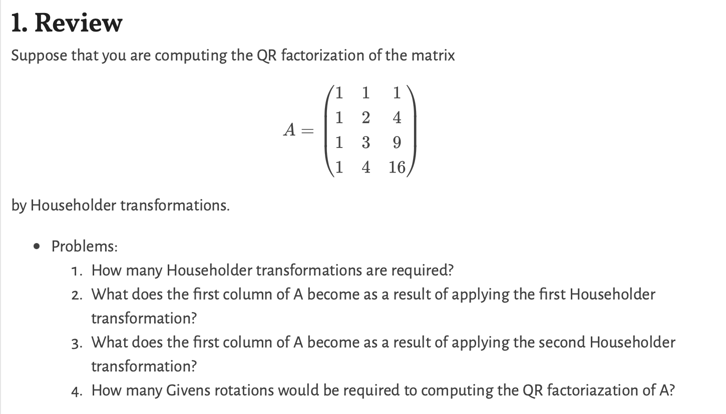
HW4
three householder transformations are required.
the first column of A after transformation will be (2,0,0,0).
the second transformation will not affect the first column of A.
6 times of Givens rotations would be required.

Slide 8
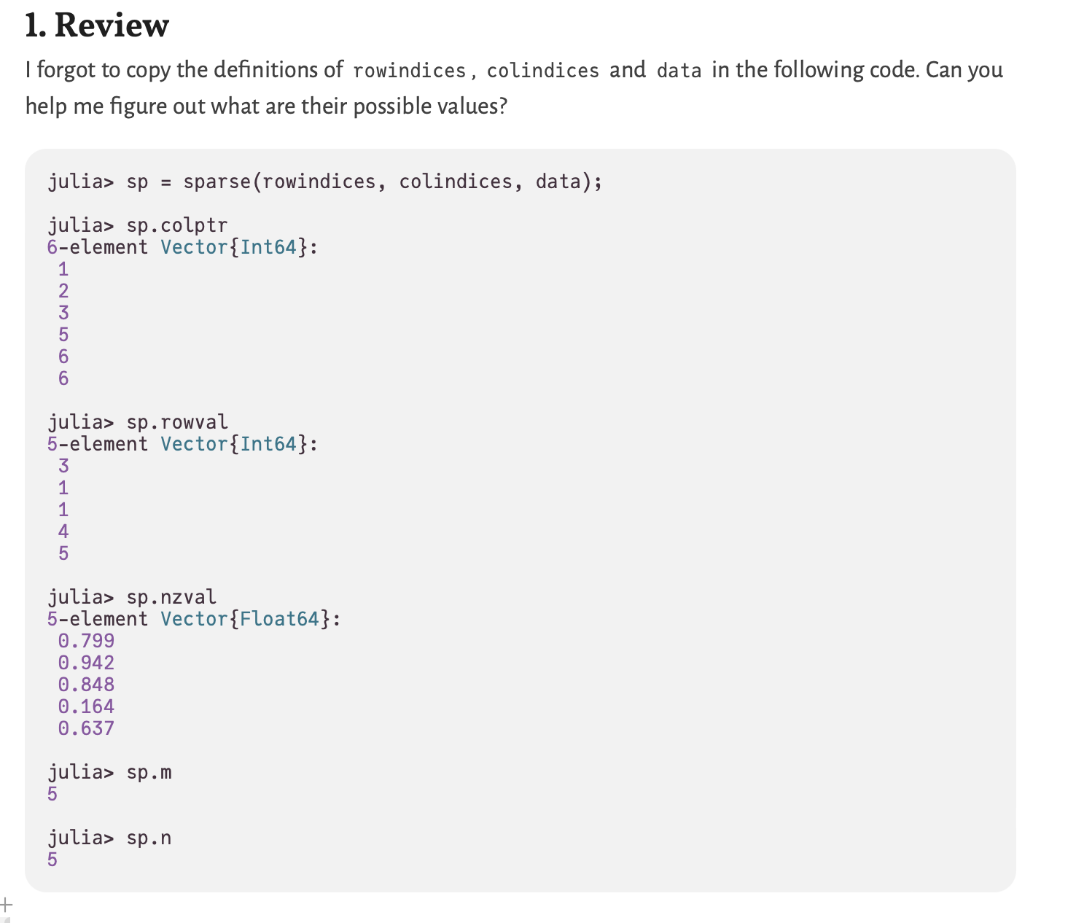
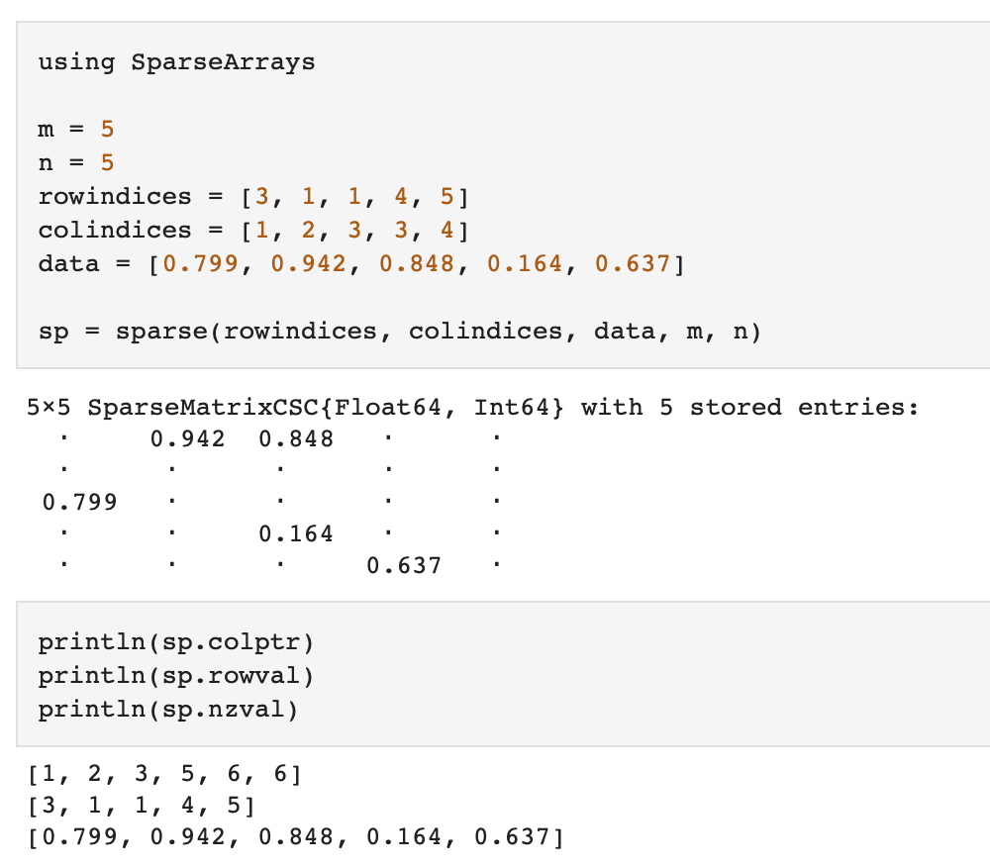
HW5

Slide 9
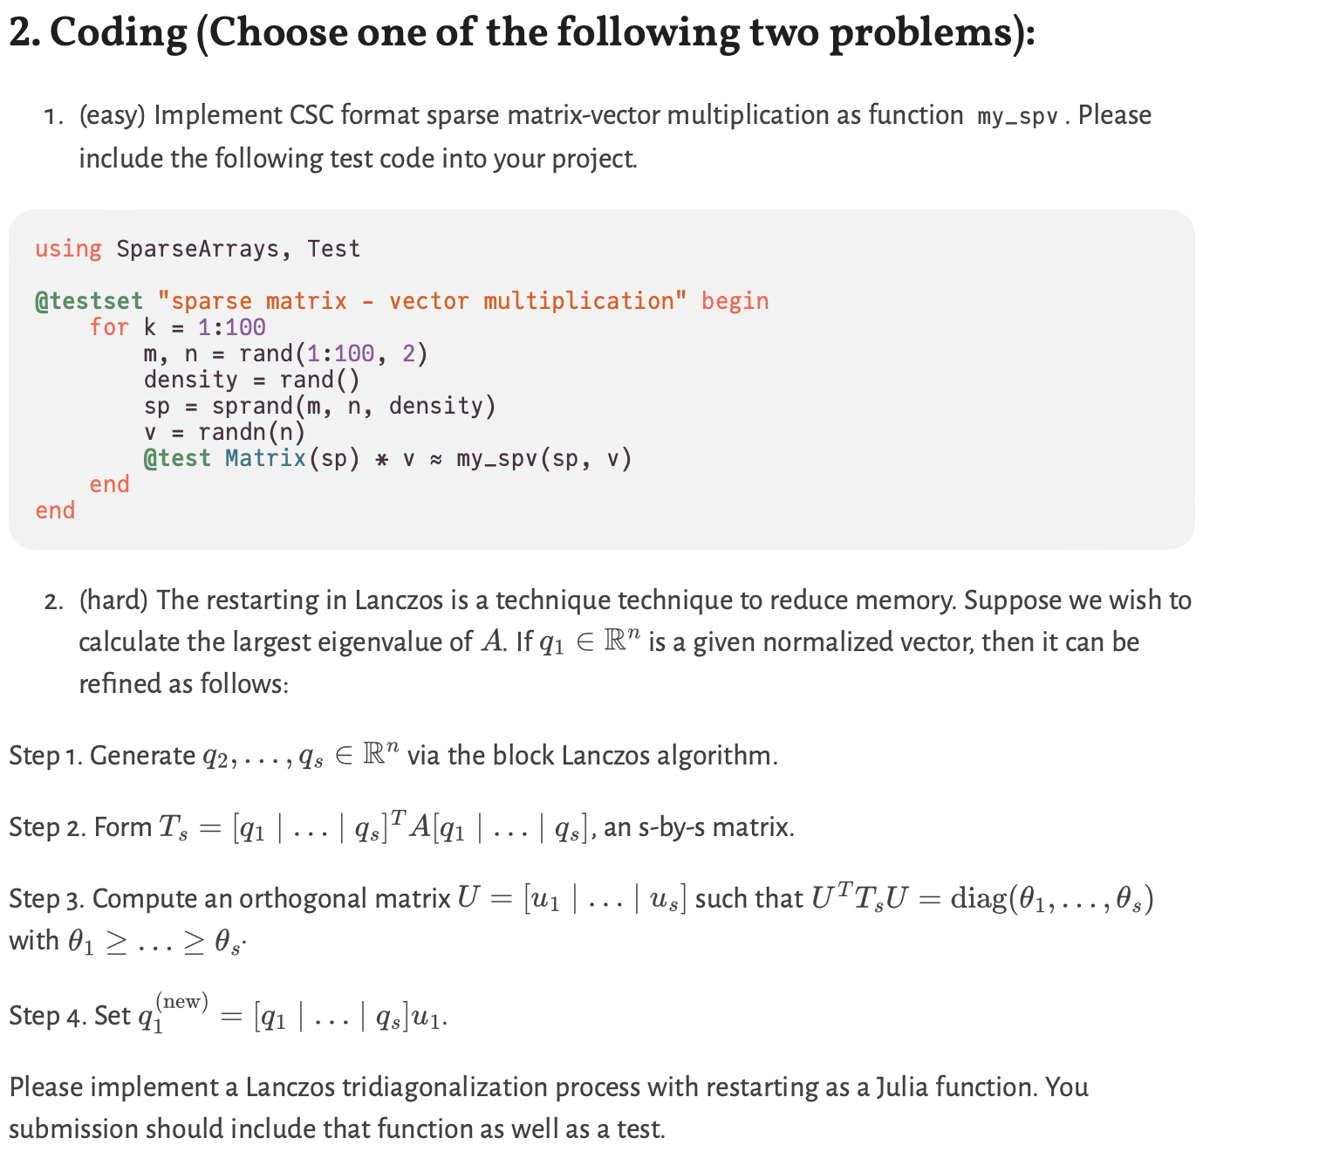
HW5

